Slide 1

Department of Computer Science & Engineering AI POWERED EMPLOYEE MANAGEMENT SYSTEM BATCH NO: 02
Maisammaguda, Kompally, Medchal - Malkajgiri District Hyderabad - 500100, Telangana State. www.mallareddyuniversity.
(Telangana State Private Universities Act No. 13 of 2020 &
G.O.Ms. No. 14, Higher Education (UE) Department)
1.2411CS010054(B.Raj Kiran) 2.2411CS010057(B.Sanjay Reddy) 3.2411CS010061(B.Srivani) 4.2411CS010078(B.Kavya Sri)
5.2411CS010079(B.Manideep)

Slide 2
Table of Contents
Abstract
Introduction
Limitations of Existing Systems
Literature survey
Proposed system
Existing system
Data flow diagram
System architecture
Hardware and software requirements
Screenshots of working model
Results
Conclusion

Slide 3
ABSTRACT
An AI-powered employee management system is a modern solution designed to streamline workforce
operations by integrating artificial intelligence into everyday HR and organizational tasks. It enhances
traditional management systems through the use of data-driven insights, automation, and predictive
analytics, enabling efficient decision-making. The system can automate routine tasks such as attendance
tracking, payroll management, and performance evaluation, thereby reducing manual effort and minimizing
errors.
The system also leverages AI techniques to analyze employee behavior, productivity, and engagement
levels, providing valuable insights to managers for improved performance. It includes intelligent chatbots
to assist employees with queries and uses natural language processing for sentiment analysis, helping organizations understand workplace morale. Overall, this system transforms workforce management into
a smarter, more efficient, and adaptive process, promoting productivity, employee growth, and
organizational success.
:

Slide 4
INTRODUCTION
The AI-Based Employee Management System (EMS Pro) is a web-based enterprise HR
automation platform designed to streamline and optimize organizational workforce management.
The system integrates an AI-powered Chatbot that allows employees to generate official letters,
request information, and interact with the system intelligently.
Administrators can analyze CSV files, monitor attendance records, track department-wise
performance, and generate real-time analytics dashboards for better decision-making.
EMS Pro replaces manual HR operations with a smart, scalable, AI-driven, and data-centric
solution, improving efficiency, transparency, and productivity across the organization.
Additionally, the system supports 25+ languages (including 15+ Indian and 10+ foreign
languages), ensuring multilingual accessibility and global usability.

Slide 5
LIMITATION OF EXISTING SYSTEM
Most traditional Employee Management Systems rely heavily on manual data entry and spreadsheet
-based record maintenance, which increases the chances of human error and data inconsistency.
Manual and time-consuming HR operations
Limited automation and no AI-based chatbot assistance
No automated letter or document generation
Basic attendance tracking without advanced CSV analytics
Lack of real-time dashboards and decision-support insights
Poor scalability for growing organizations
No multilingual support for regional and global accessibility
These limitations reduce operational efficiency, transparency, and data-driven decision-making
within organizations.

Slide 6
LITERATURE SURVEY
Existing Employee Management Systems mainly focus on employee data storage, attendance tracking, payroll, and leave management.
Most traditional systems provide basic reporting features but lack AI-based automation and intelligent interaction.
Recent advancements in Artificial Intelligence (AI) and Natural Language Processing (NLP) enable the use of AI chatbots for automated communication and document generation.
However, existing solutions do not effectively combine:
AI-powered chatbot
CSV-based attendance analytics
Real-time dashboards
25+ multilingual support
Our system integrates these features into a single scalable enterprise platform.

Slide 7
PROPOSED SYSTEM
The proposed system, AI-Based Employee Management System (EMS Pro), is a
web-based enterprise HR automation platform designed to overcome the limitations of traditional systems
It introduces AI-driven automation, intelligent chatbot interaction, and advanced data analytics
to improve organizational efficiency.
Integration of an AI-powered chatbot for employee assistance and automatic letter generation
Smart CSV-based attendance and department analytics
Interactive real-time dashboard for administrators
Secure role-based authentication system
Centralized employee data management
The proposed system ensures automation, transparency, accuracy, and data-driven
decision-making in workforce management.

Slide 8
EXISTING SYSTEM
Existing System: The existing employee management systems are mostly based on manual processes or basic digital tools such as spreadsheets and standalone applications. These systems require
personnel to manually handle tasks like employee data entry, attendance tracking, payroll processing, and performance evaluation. This not only consumes a lot of time but also increases the chances of human errors, data inconsistency, and duplication.
In addition, traditional systems lack advanced automation and intelligence. They do not provide real-time analytics, predictive insights, or data-driven decision-making support. There is no integration of AI technologies such as chatbots for employee assistance or natural language processing for feedback analysis. Most systems also lack centralized data management, scalability, and multilingual support, making them less effective for growing organizations. As a result, these limitations lead to reduced efficiency, poor employee engagement, and difficulty in managing workforce operations effectively.

Slide 9
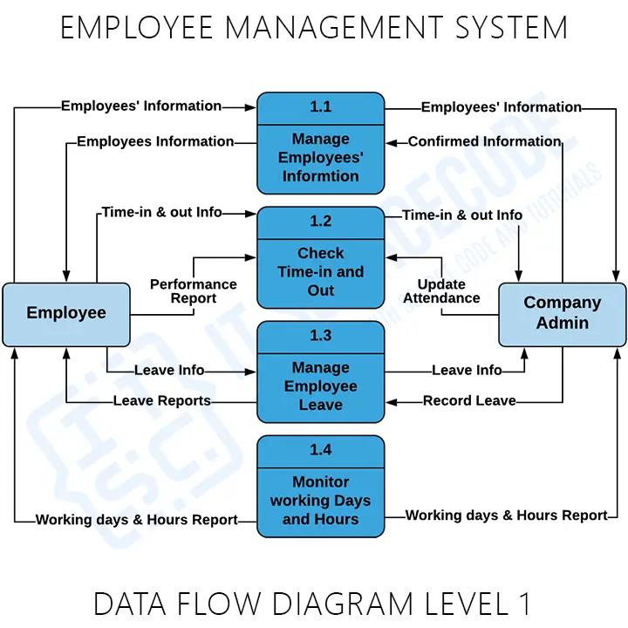
DATA FLOW DIAGRAM

Slide 10
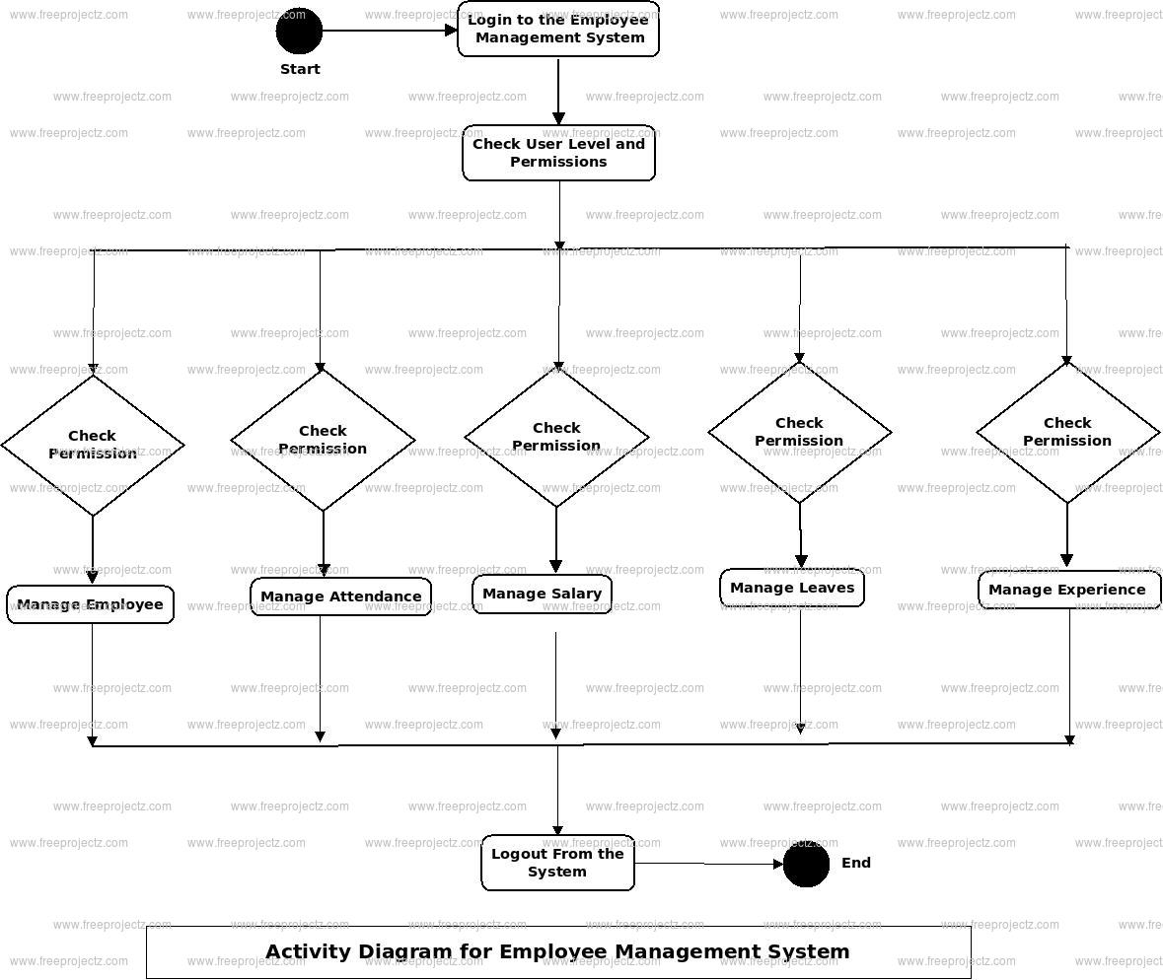
SYSTEM ARTICHITECTURE

Slide 11
HARDWARE AND SOFTWARE REQURIMENT
Hardware Requirements
Processor: Intel Core i3 or higher
RAM: Minimum 4 GB (8 GB recommended)
Storage: 20 GB free disk space
System Type: 64-bit architecture
Internet Connection: Required for deployment and API integration
Software Requirements
Operating System: Windows 10/11 / Linux / macOS
Frontend: React.js
Backend: Node.js / Express (or Python Flask)
Database: MongoDB
Programming Languages: JavaScript, Python
Browser: Google Chrome / Microsoft Edge
Version Control: Git & GitHub
Development Tools: VS Code

Slide 12
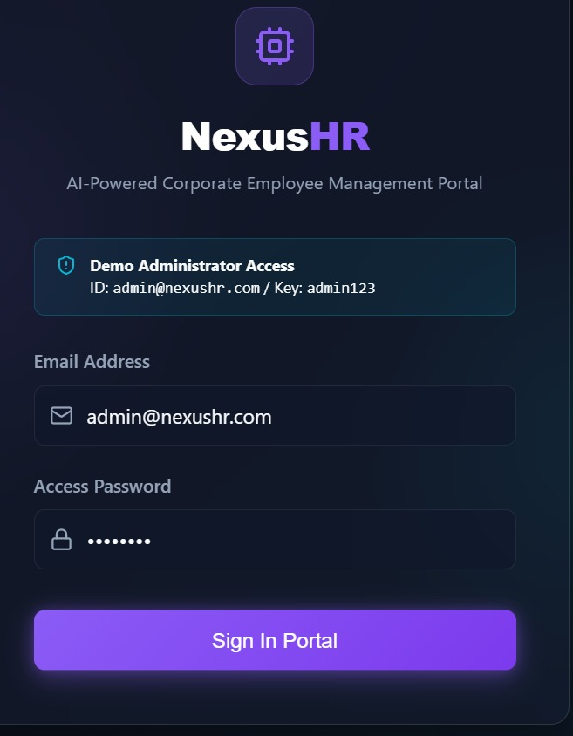
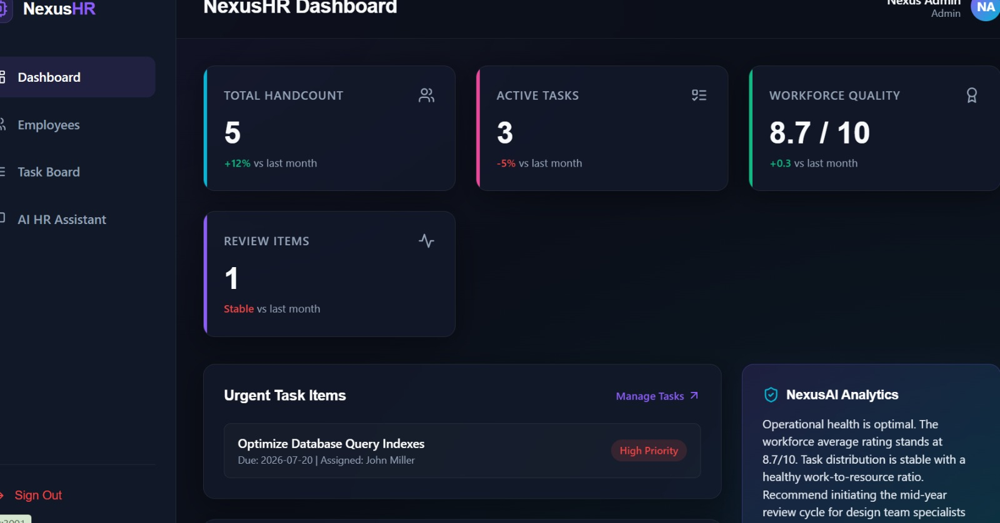
SCREEN SHOTS

Slide 13
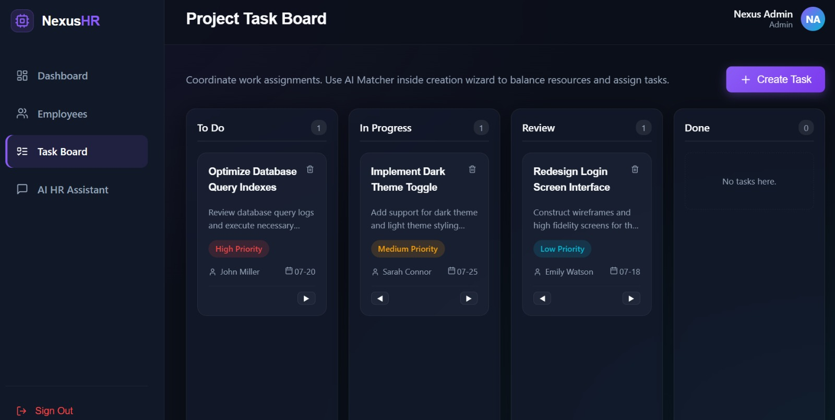
SCREEN SHOTS

Slide 14
CONCULSION
The AI-Based Employee Management System (EMS Pro) is a comprehensive and scalable HR automation platform designed to modernize traditional workforce management.
It integrates an AI-powered chatbot for intelligent employee interaction and automatic letter generation.
The system enables administrators to perform CSV-based attendance analysis and monitor department performance through real-time dashboards.
With secure role-based authentication, it ensures data protection and controlled access.
The inclusion of 25+ multilingual support enhances accessibility for regional and global users.
Overall, EMS Pro improves efficiency, transparency, and data-driven decision-making, making it an enterprise-ready HR solution.

Slide 15
THANK YOU

